Slide 1

2025 District AD Meetings
Central District
Ankeny, IA
IOWA HIGH SCHOOL ATHLETIC ASSOCIATION
IHSAA Staff
Tom Keating, Executive Director
Jared Chizek
Chad Elsberry
Tyler Lown
Todd Tharp
Andy Umthun

Slide 2
IOWA HIGH SCHOOL ATHLETIC ASSOCIATION
What drives us…
If we remain stagnant, we will become irrelevant.
Formula 1 Pit Stops

Slide 3
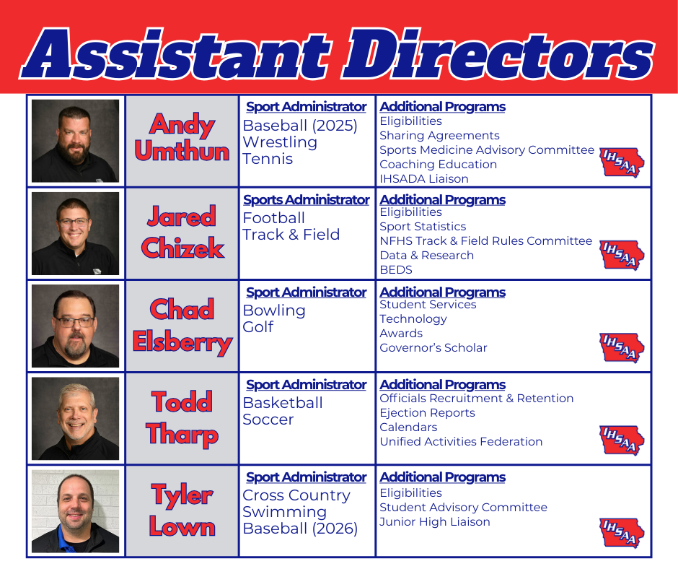

Slide 4
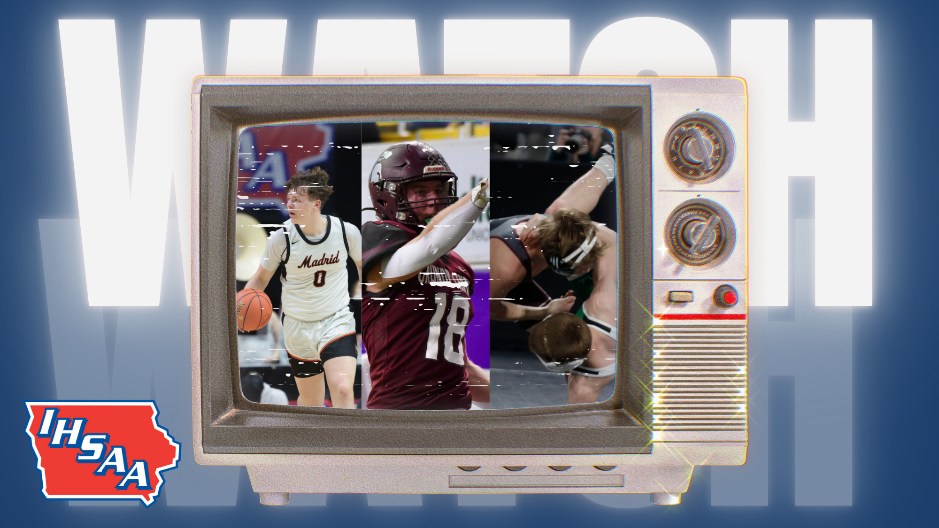
2025-26 Broadcast Plan
IOWA HIGH SCHOOL ATHLETIC ASSOCIATION
BROADCAST UPDATE
Reacquired media rights from IHSSN
Plan: Easy + Accessible.
Free streaming
Agreement with Iowa PBS (March)
Agreements to TV affiliates (August)
  OTA statewide, Dot/Dash
State Tournament productions from:
  Football
  Wrestling
  Swimming
  Basketball
  Track & Field
  Soccer
  Baseball

Slide 5
How To Watch
Click on Watch: 2025-26
IOWA HIGH SCHOOL ATHLETIC ASSOCIATION
BROADCAST UPDATE
Sport | Dates | IHSAA Stream | Tourney Partners | Iowa PBS
Football | Nov. 12-15; 21-22 | Semis, Finals | Semis | Finals
Wrestling, Duals | Feb. 7 | Finals | Finals
Swimming | Feb. 13-14 | State Meet | State Meet
Wrestling, Tourney | Feb. 18-21 | Semis | Semis | Finals
Basketball | March 9-13 | All | Quarters, Semis | Finals
Track & Field | May 21-23 | State Meet | State Meet
Soccer | June 3-5 | Semis, Finals | Semis, Finals
Baseball | July 20-24 | All | All

Slide 6
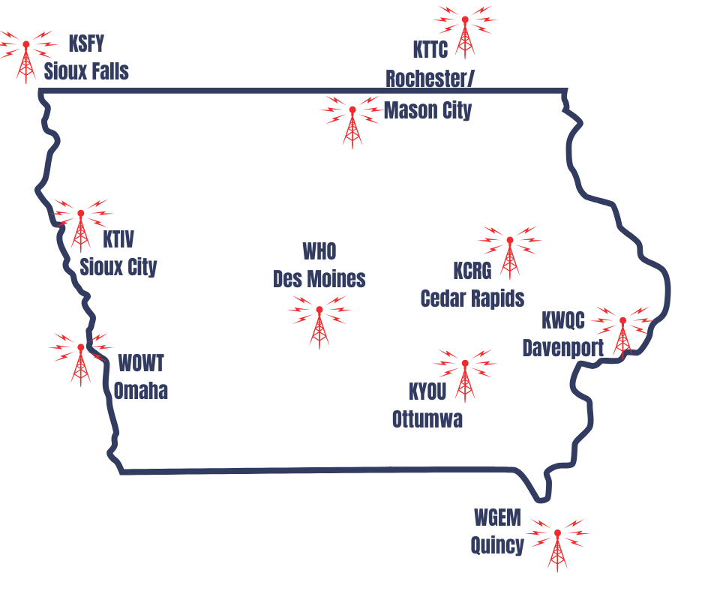
Broadcast Partners
IOWA HIGH SCHOOL ATHLETIC ASSOCIATION
BROADCAST UPDATE
Iowa PBS
  Football, Wrestling, Basketball
  Finals Only
Marquee Sports Network
Mediacom, MC22
Nexstar
  WHO, Des Moines
Gray Media
  KCRG, Cedar Rapids
  KSFY, Sioux Falls
  KTIV, Sioux City
  KTTC, Mason City/Rochester
  KWQC, Davenport
  KYOU, Ottumwa
  WGEM, Quincy
  WOWT, Omaha
  North Star Sports Network (MN)

Slide 7
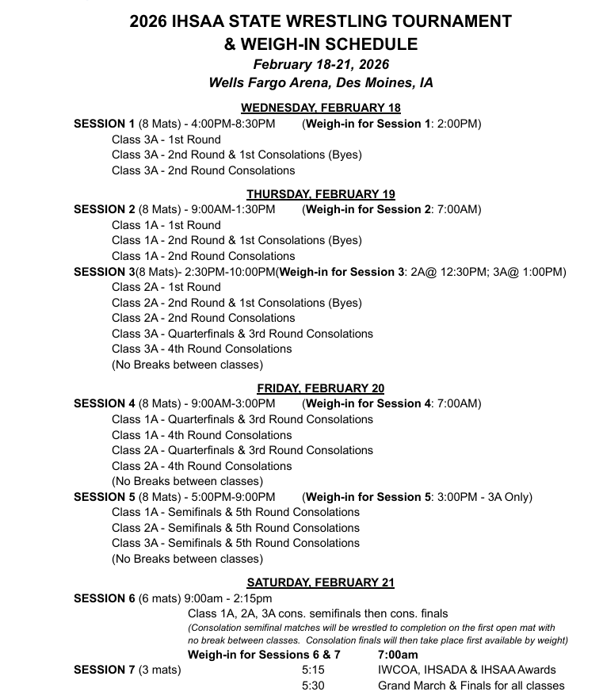
2025-26 Highlights
IOWA HIGH SCHOOL ATHLETIC ASSOCIATION
Wrestling Updates
Adjusted Traditional State Tournament Schedule
Official weigh in on site for all levels (utilize consecutive day allowance)
1 weigh in open at a time
District host sites have discretion to utilize 2 or 3 mats for first tow rounds if facility can support it.

Slide 8
2025-2026 Basketball
IOWA HIGH SCHOOL ATHLETIC ASSOCIATION
Regular Season:
Per a recommendation from the Basketball Advisory Committee and approval of the IHSAA Board of Control the quarter limitation has been eliminated.
Each individual is permitted to participate in 44 regular season contests. One quarter equals one contest.
Example: IHSAA High School is scheduled for a JV/Varsity doubleheader. Todd Tharp plays in 4 quarters of the junior varsity contest and plays in 2 quarters of the varsity contest. How many contests are counted against him?
Answer: Todd Tharp has played in 2 contests and has 42 contests remaining to play in.
Example: IHSAA High School is scheduled for a 9th/JV/Var tripleheader. Todd Tharp plays in 4 quarters of the 9th grade contest, 2 quarters of the JV contest and 1 quarter of the varsity contest. How many contests are counted against him?
Answer: Todd Tharp has played in 3 contests. He has 41 contests to play in.
Notes:
Chance to connect in smaller setting, by class and conference

Slide 9
2025-2026 Basketball
IOWA HIGH SCHOOL ATHLETIC ASSOCIATION
Postseason:
Per a recommendation from the Basketball Advisory Committee and approval of the IHSAA Board of Control the Class 1A and Class 2A District Final contests will be played at the higher seeded facility.
Minimum seating capacity for Class 1A District Finals: 800
Minimum seating capacity for Class 2A District Finals: 1,000
These minimums were determined based on attendance figures over the past 5 years.
Seating capacities are determined by information sent in by schools. Each Class 1A and Class 2A school provided the IHSAA with their gym's seating capacity.
If the higher seeded team does not meet the minimum seating capacity, they can elect to contact another school that meets the seating capacity and the contest can be played there. If the higher seeded team cannot find another school to host, the contest will be moved to the lower seeded team's site. If the lower seeded team cannot meet the seating capacity minimums, the IHSAA will determine the location of the contest.
Class 1A and Class 2A Substate Finals will still be held at neutral sites assigned by the IHSAA.
Notes:
Chance to connect in smaller setting, by class and conference

Slide 10
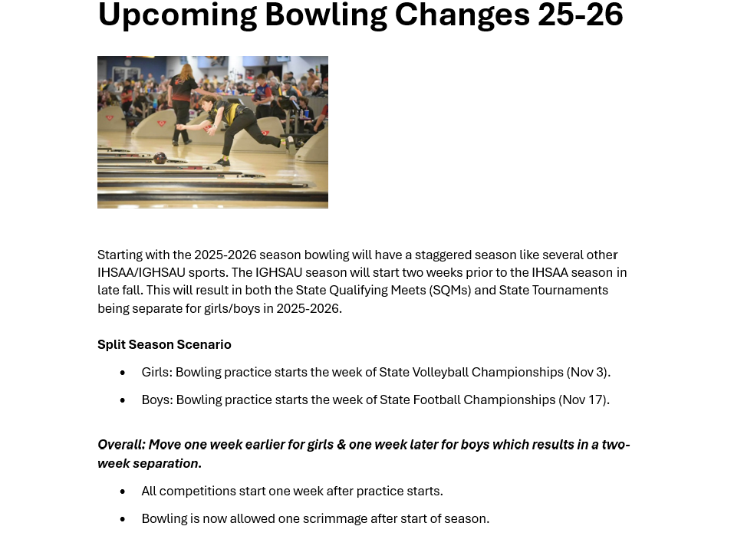
IOWA HIGH SCHOOL ATHLETIC ASSOCIATION
Notes:
Chance to connect in smaller setting, by class and conference

Slide 11
2026 Tennis Season Highlights
IOWA HIGH SCHOOL ATHLETIC ASSOCIATION
Tennis Updates
Substate Team Tennis
  Now only top 32 teams from each class will participate in the substate team tennis tournament
  Top 32 will be identified by a combination of coaches’ rankings poll, UTR, and overall record/strength of schedule as metrics.
  One day: 4-team bracket @ 8 sites for each class
Substate & State Team Tennis Format
  Both Substate & State Team Tennis Tournaments will begin with doubles, followed by singles
  Still first team to 5
  Based on time, facilities, participation numbers, etc., format and scoring will still be local control during the regular season.
Postseason Dates
  District Singles & Doubles – Saturday, May 16 (week 45 of NFHS calendar)
  Substate Team Tennis – Wednesday, May 20 (week 46 of NFHS calendar)
  State Singles & Doubles – May 27-28
  State Team Tennis – June 3-4

Slide 12
2025-2026 Baseball
IOWA HIGH SCHOOL ATHLETIC ASSOCIATION
Postseason Dates:
Class 1A/2A: July 3,7,11,14
Class 3A/4A July 10,13,15
State Baseball: July 20-24
Class 3A/4A -Cedar Rapids
Class 1A/2A- Carroll
*Sites locked in through 2028 Season*
Notes:
Chance to connect in smaller setting, by class and conference

Slide 13
Conference AD Meetings Tour
IOWA HIGH SCHOOL ATHLETIC ASSOCIATION
Why?
Opportunity to listen and gain feedback
Looking for themes
Proactive
We will share what we heard at State AD Convention
Notes:
Chance to connect in smaller setting, by class and conference

Slide 14
IOWA HIGH SCHOOL ATHLETIC ASSOCIATION
Legislation
HF189
  Junior High
  Out of State
  Fees
  .25 count on Co-ops
HF783
  Committee
  Fast-Track vs. Full Review
  Timing

Slide 15
IOWA HIGH SCHOOL ATHLETIC ASSOCIATION
IHSAA Achieve Foundation
Why?
Vision is to support:
  IHSAA Education/Leadership Initiatives
    Student Council
    Conference Connections
    Violence Prevention
  Grants for school initiatives
    Safety, Leadership, Sportsmanship
  AD Professional Development
    National and State Conferences, LTI Courses, AD Mentoring Program

Slide 16

IOWA HIGH SCHOOL ATHLETIC ASSOCIATION

